Slide 1
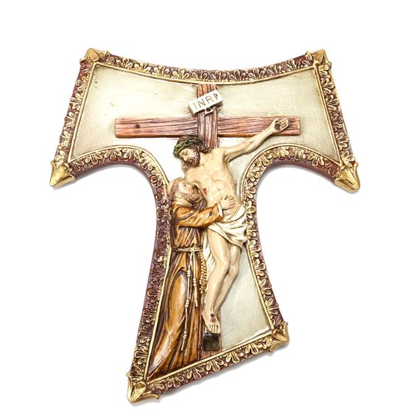
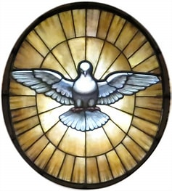
FYYA 2024 ARG
They are our collective future

Slide 2
What does Our Holy Father say
. Christ is alive! He is our hope, and in a wonderful way he brings youth to our world, and everything he touches becomes young, new, full of life. The very first words, then, that I would like to say to every young Christian are these: Christ is alive and he wants you to be alive!

Slide 3
AND
From what the Gospel tells us, we can say that Jesus, in the years of his youth, was “training”, being prepared to carry out the Father’s plan. His adolescence and his youth set him on the path to that sublime mission.

Slide 4
We are called
“The stars shine in their watches, and are glad; he calls them and they say: ‘Here we are!’” (Bar 3:34-35). Christ himself is our great light of hope and our guide in the night, for he is the “bright morning star” (Rev 22:16).

Slide 5
ST. Francis is our example
Saint Francis of Assisi, while very young and full of great dreams, heard Jesus’ call to become poor like him and to rebuild the Church by his witness. He joyfully renounced everything he had and is now the saint of universal fraternity, the brother of all. He praised the Lord for his creatures.

Slide 6
We have many examples
Saint Joan of Arc was born in 1412. She was a young peasant girl who, despite her tender years, fought to defend France from invaders. Misunderstood for her demeanour, her actions and her way of living the faith, Joan was burned at the stake.

Slide 7
And more examples
Blessed Andrew Phû Yên was a young Vietnamese man of the seventeenth century. He was a catechist and assisted the missionaries. He was imprisoned for his faith, and since he refused to renounce it, he was killed. Andrew died uttering the name of Jesus.

Slide 8
Young people influenced our faith
In that same century, Saint Kateri Tekakwitha, a young native of North America, was persecuted for her faith and, to escape, walked over three hundred kilometres in the wilderness. Kateri consecrated herself to God and died saying: “Jesus, I love you!”

Slide 9
Another example, 14 yr. old!
Saint Dominic Savio offered all his sufferings to Mary. When Saint John Bosco taught him that holiness involves being constantly joyful, he opened his heart to a contagious joy. He wanted to be close to the most abandoned and infirm of his fellow young people. Dominic died in 1857 at fourteen years of age, saying: “What a wondrous thing I am experiencing!”

Slide 10
Around the world!
Blessed Isidore Bakanja was a layman from the Congo who bore witness to his faith. He was tortured at length for having proposed Christianity to other young people. Forgiving his executioner, Isidore died in 1909.

Slide 11
So I ask you
May these and so many other young people who perhaps in silence and hiddenness lived the Gospel to the full, intercede for the Church, so that she may be full of joyous, courageous and committed young people who can offer the world new testimonies of holiness.
what is your community / fraternity doing?

Slide 12

These are our FYYA animators?!?
Kelly Horwitz,David Rohr,Danny Navarro, Joshua Strope, Donald Macnamara, Anne Evangelista, Elizabeth Sandy
We have 27 fraternities
What are the obstacles? Real or perceived
Discussion?

Slide 13
How do we move forward?
Change the format of regular training
Take attendance
Establish Key Performance Indicators (how is each fraternity doing –report card of sorts)
Continue basic training fornew folks
Create advanced training for established folks
Share success stories

Slide 14
We will keep
The original core four for those just beginning in their endeavors with youth
But we must begin

Slide 15
Meeting format moving forward
Basic Format will serve as a model for animators to learn how to do their own training and hold meetings with young people.
Meetings will include four components we have in our fraternity gatherings:
prayer, social time/sharing, formation, and little bit of business if necessary.
Open the zoom room early for chatting.
Begin with prayer.
Introductions
Introduce topic of the evening.
Include small group sharing .
Twenty-thirty minutes of presentation
Begin and end promptly.
Include story telling/sharing, short.
Include young people whenever possible to get their perspective.

Slide 16
More specifically
2 minutes: Opening prayer
10 minutes: Intros/check-in
5 minutes: Centering scripture passage and/or moment from life of saint
5 minutes: Discussion and/or activity in small or large group
20 minutes: Presentation of the day ending with concrete homework
10 minutes: Large or small group discussion
2 minutes: Closing prayer

Slide 17
Potential path forward
Our Vision: Young People have…
1) A desire to be part of a community.
-strong community/relationship
-what is fraternity
2) A desire for prayer and spiritual growth.
-prayer experiences
-Bible studies
-dedication to Christ/Church

Slide 18
Continued path forward
· 3) A desire to be of service.
-care for creation
-discovering talents/sharing gifts
-outreach to the poor and marginalized
-seven areas of Catholic Social Teaching
· 4) A call to and strengthening of vocations, including a vocation to religious life.
-what is vocation/how to discover God’s will.
-opportunities to strengthen vocations
5) Conflict Resolution
-peaceful resolution
-how to dialogue
-seeking to understand
-dealing with anger
-steps toward healing

Slide 19
Potential syllabus
September 2024: Listening Session and Overview of Franciscan Spirituality
Goal 1: Provide the opportunity for everyone to speak about where they are and what are their hopes and dreams
Goal 2: Discussion of goal setting for the next year
Goal 3: Discussion of Francis being a man of contradiction and how that is attractive for young people
Homework: Each person comes up with 2-3 SMART goals
October 2024: Sharing of SMART Goals and Discussion about Young People Today
Goal 1: Have each person share their SMART goals for the year
Goal 2: Provide information about who are young people today, where are they, and what are they searching for
Homework: See how one sees the information from the meeting in their local context.
reach at least 1 young person in the advent or Christmas season (Greccio, service to the poor, caroling).

Slide 20
continued
November 2024: Francis and the Incarnation
Goal 1: Explain why Christmas is so important in Franciscan Spirituality
Goal 2: Explore concrete ways that can be employed to reach young people in the advent and Christmas seasons
Homework: Try to do one thing to

Slide 21
continued
December 2024: Intro to the 5 Pillars of Franciscan Spirituality
Goal 1: Provide an outline to what will be covered over the next year
January 2025: Strong Community Relations
Objective: Explain what St. Francis meant by stating ‘The Lord Gave Me Brothers’ and provide concrete examples of how one can provide a sense of community for youth.

Slide 22
continued
February 2025: Dedication to Christ in the Church- The Gospel
Objective: Explain what ‘living the Gospel life’ meant to St. Francis and how is the basis of the Church. Provide concrete ways that one can reach out to youth to ‘repent and believe in the Gospel’ during Lent.
March 2025: Dedication to Christ in Church- The Eucharist
Objective: Explain why St. Francis had such a devotion to the Eucharist and provide concrete examples of how we can instill a love for the Eucharist in the lives of young people today.

Slide 23
continued
April 2025: Outreach to the Marginalized- Community Service
Objective: Explain the significance of the encounter of St. Francis and the Leper and how one can provide similar experiences for young people today.
May 2025: Outreach to the Marginalized- Sin and Acceptance
Objective: Explain what St. Francis meant to ‘Go Rebuild My Church’ and what is the role of the Church in the modern world? How can we reach out to youth who are no always living according to Church teaching?

Slide 24
continued
September 2025: Care for God’s Creation- Seeing God in Creation
Objective: Explore St. Francis’ Canticle of the Creatures and explore ways that we can attract young people by using the beauty of God’s creation to inspire them.
October 2025: Care for God’s Creation- Building up God’s Kingdom
Objective: Define vocation and explain the basics of discernment.

Slide 25
continued
November 2025: Care for God’s Creation- Living Out One’s Vocation
Objective: Explore ways to attract young people to explore the various vocations of the Church.
December 2025: Peaceful Resolution of Conflict
Objective: Explain the story of Francis and the Sultan. Explore methods to help youth people with conflict resolution and promoters of peace in society.

Slide 26
Summary
The harvest is ripe but the laborers are few
We have a great programs to help fraternities discover the path forward
What level of commitment exists?
Are you using this position to develop future fraternity leaders
If not us then who??? “I have done what is mine to do” , Have you?

